Slide 1
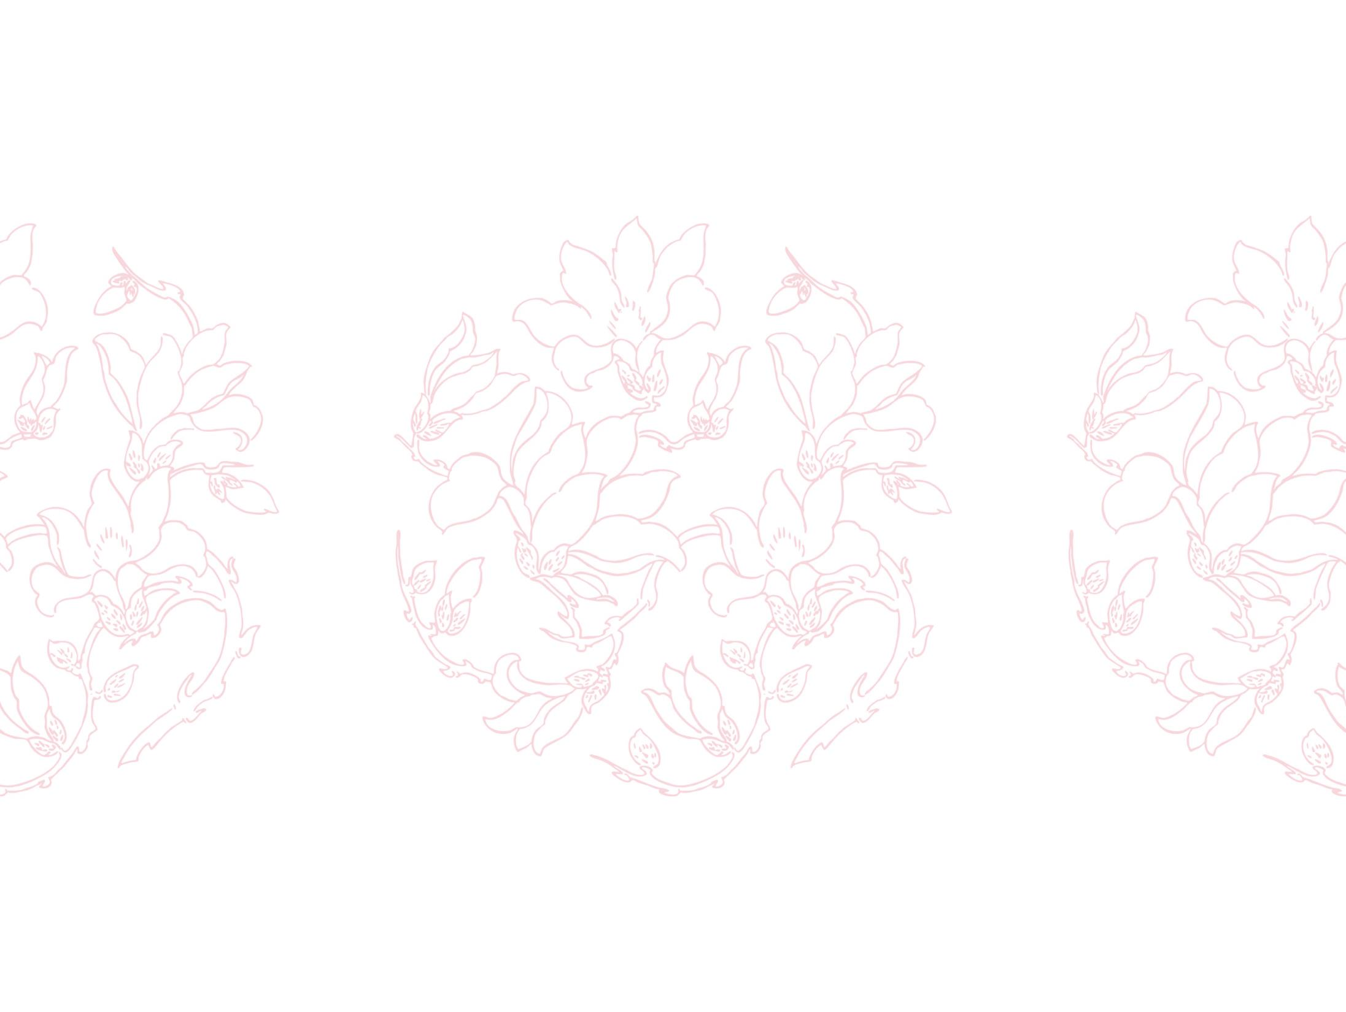


VQA: Visual question answering
组员：彭小康，范志康，汤婷

Slide 2

Content
Problem background
Method
Experiments
Remaining problems

Slide 3

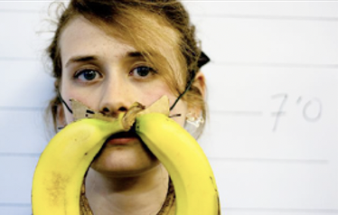
Problem background
VQA: Given an image and a natural language question about the image, the task is to provide an accurate natural language answer.
What is the mustache made of?
Question
Image
Banana
Answer

Slide 4
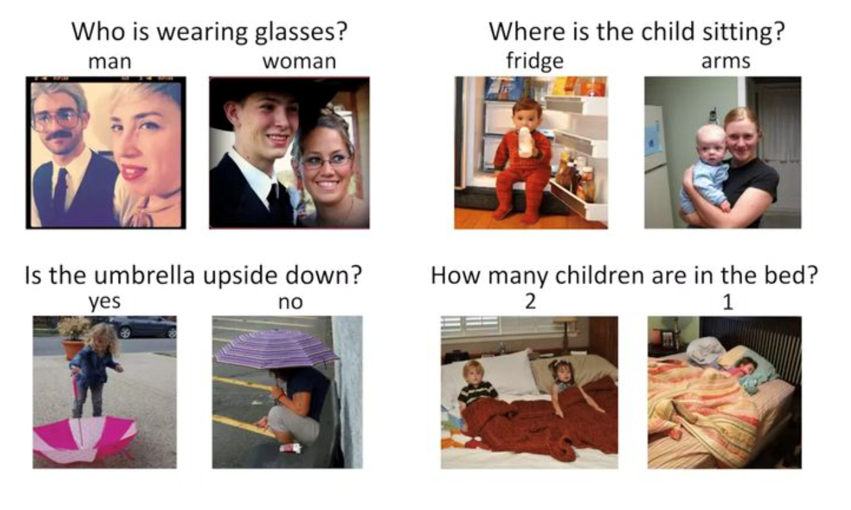
Problem background
Multiple choice VQA
Open-ended VQA

Slide 5
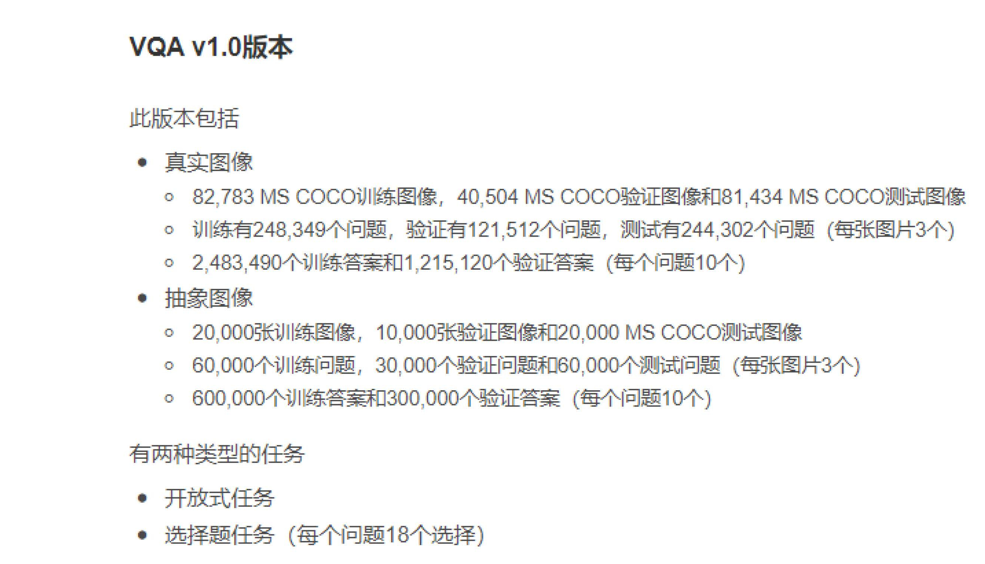
Method
Dataset

Slide 6
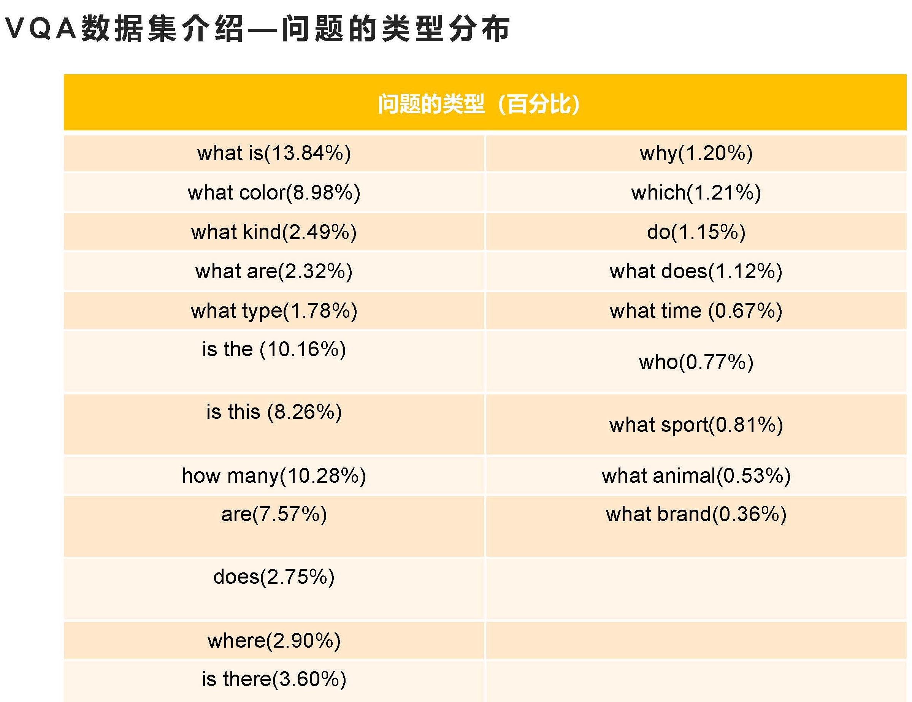
Method
Dataset

Slide 7
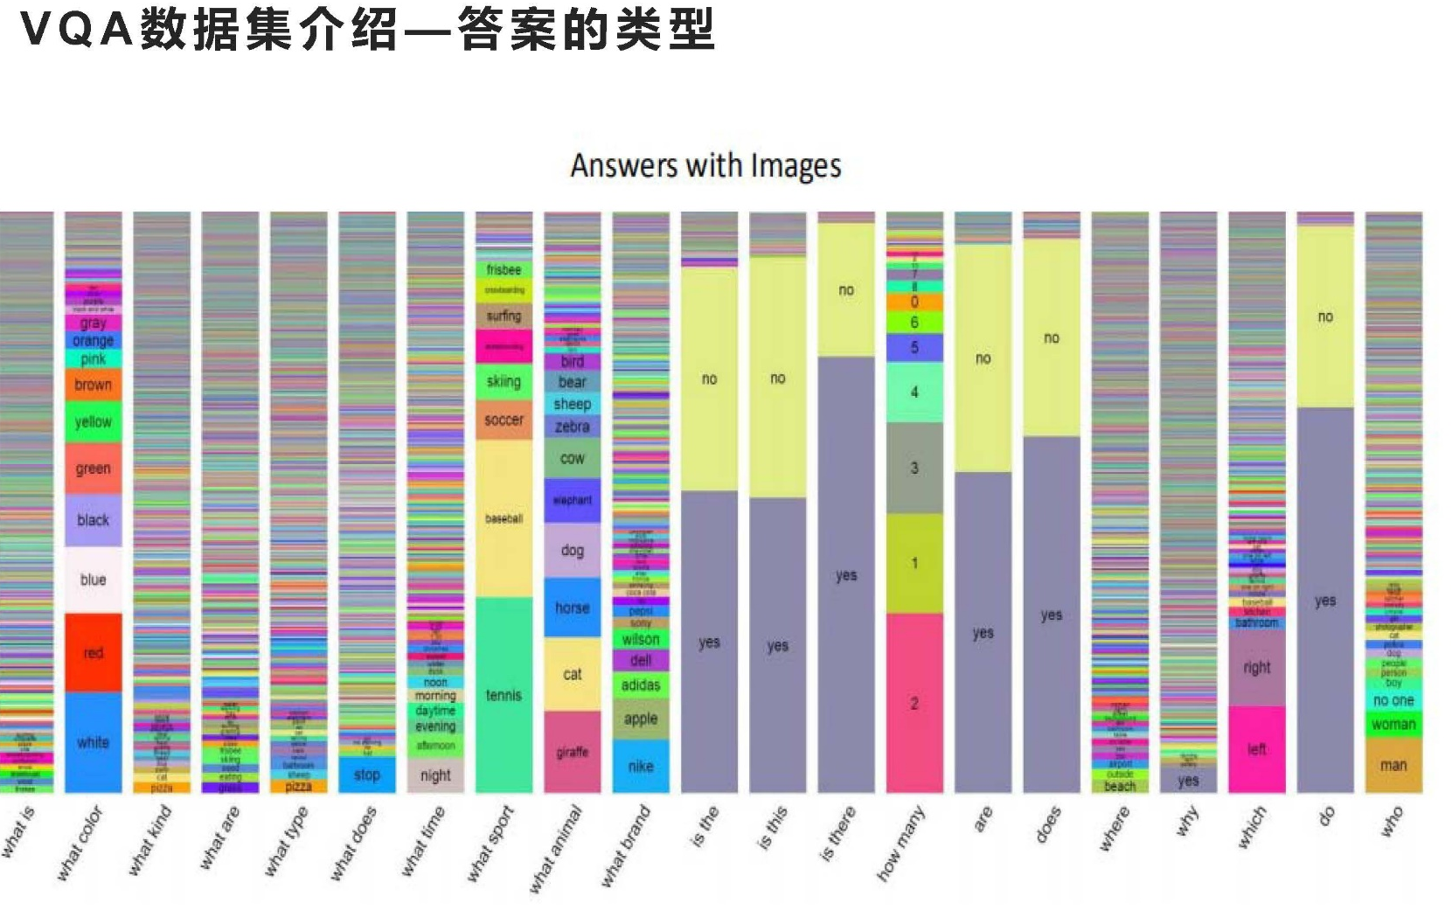
Method
Dataset

Slide 8
Method
Pipeline
MLP
Question
word embedding
LSTM/GRU
Self-attention
FC
Image
Visual encoder
prediction
+

Slide 9
Method
Setting details
Word embedding: word2vec
Visual encoder: Resnet-18
LSTM_num_ layers: 4
LSTM_ hidden_size: 128
LSTM_ bidirectional: True
Training epoch: 20
Test acc： 61.3%

Slide 10
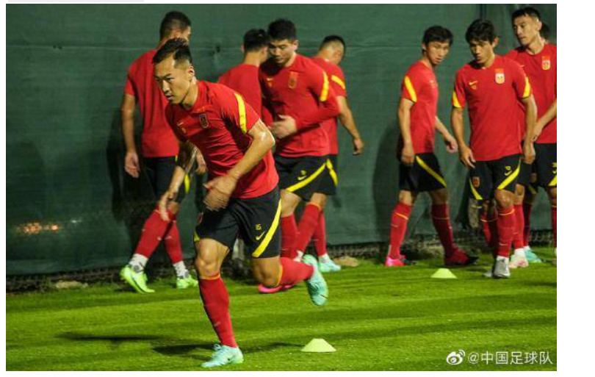
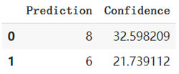
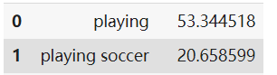
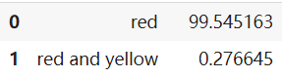
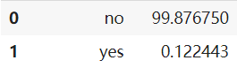
Experiments
how many man in the pic?
what are they doing?
what colour clothes are they wear?
Are there any girls in this picture?

Slide 11
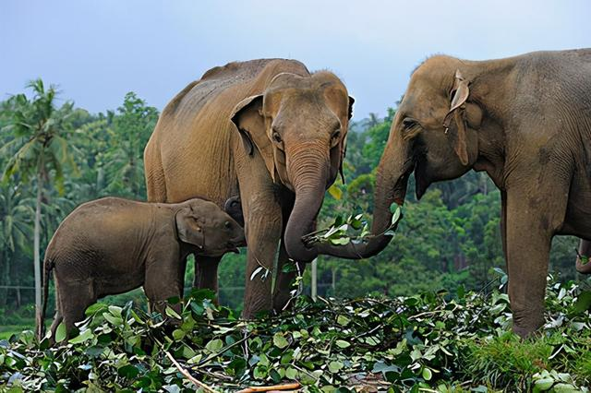
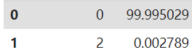
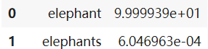
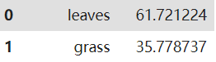
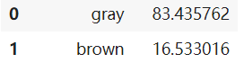
Experiments
how many man？
What animal is in the picture?
What does the elephant eat?
What colour is the elephant?

Slide 12
Remaining problems
Modality bias：human prior, data bias (need inference)
Interpretability: lack of specificity (natural language parsing)

Slide 13
Thank You!

